Slide 1

MIRPUR UNIVERSITY OF SCIENCE AND TECHNOLOGY(MUST), MIRPUR AJK
Department of Electrical Engineering
TOWARDS REDUCING HANDOFF TIME IN NEXT GENERATION WIRELESS NETWORKS
FYP MEMBERS:
Shoaib Akhtar
Zain Ramzan
FA18-BEE-021
FA18-BEE-026
Supervisor:
Dr. Sohaib Manzoor

Slide 2
INTRODUCTION
Wi-Fi networks have rapidly grown due to low costs and simple Implementation.
Wi-Fi networks will be the most used in wireless devices in 2023 (70%).
It has become our need like food.
Users demand quick accessibility when dealing with real-time data like audio & video streaming.
De-associate to one AP and associates to another AP, called Handoff time (AP - Access Point)
User could loss important information when dealing with delay sensitive application e.g OTP(one time password)

Slide 3
PROBLEM STATEMENT
In traditional Wi-Fi networks, Handoff is initiated by the wireless devices like mobile phone etc. In the Detection Phase.
Handoff is initiated on the bases of RSSI (Received Signal Strength Indicator) only.
When RSSI value is low then the Handoff is initiated which could cause the loss of important information.
Another contribution to the Handoff delay occurs in the Discovery phase.
The traditional handoff scenario is depicted in Figure 1

Slide 4
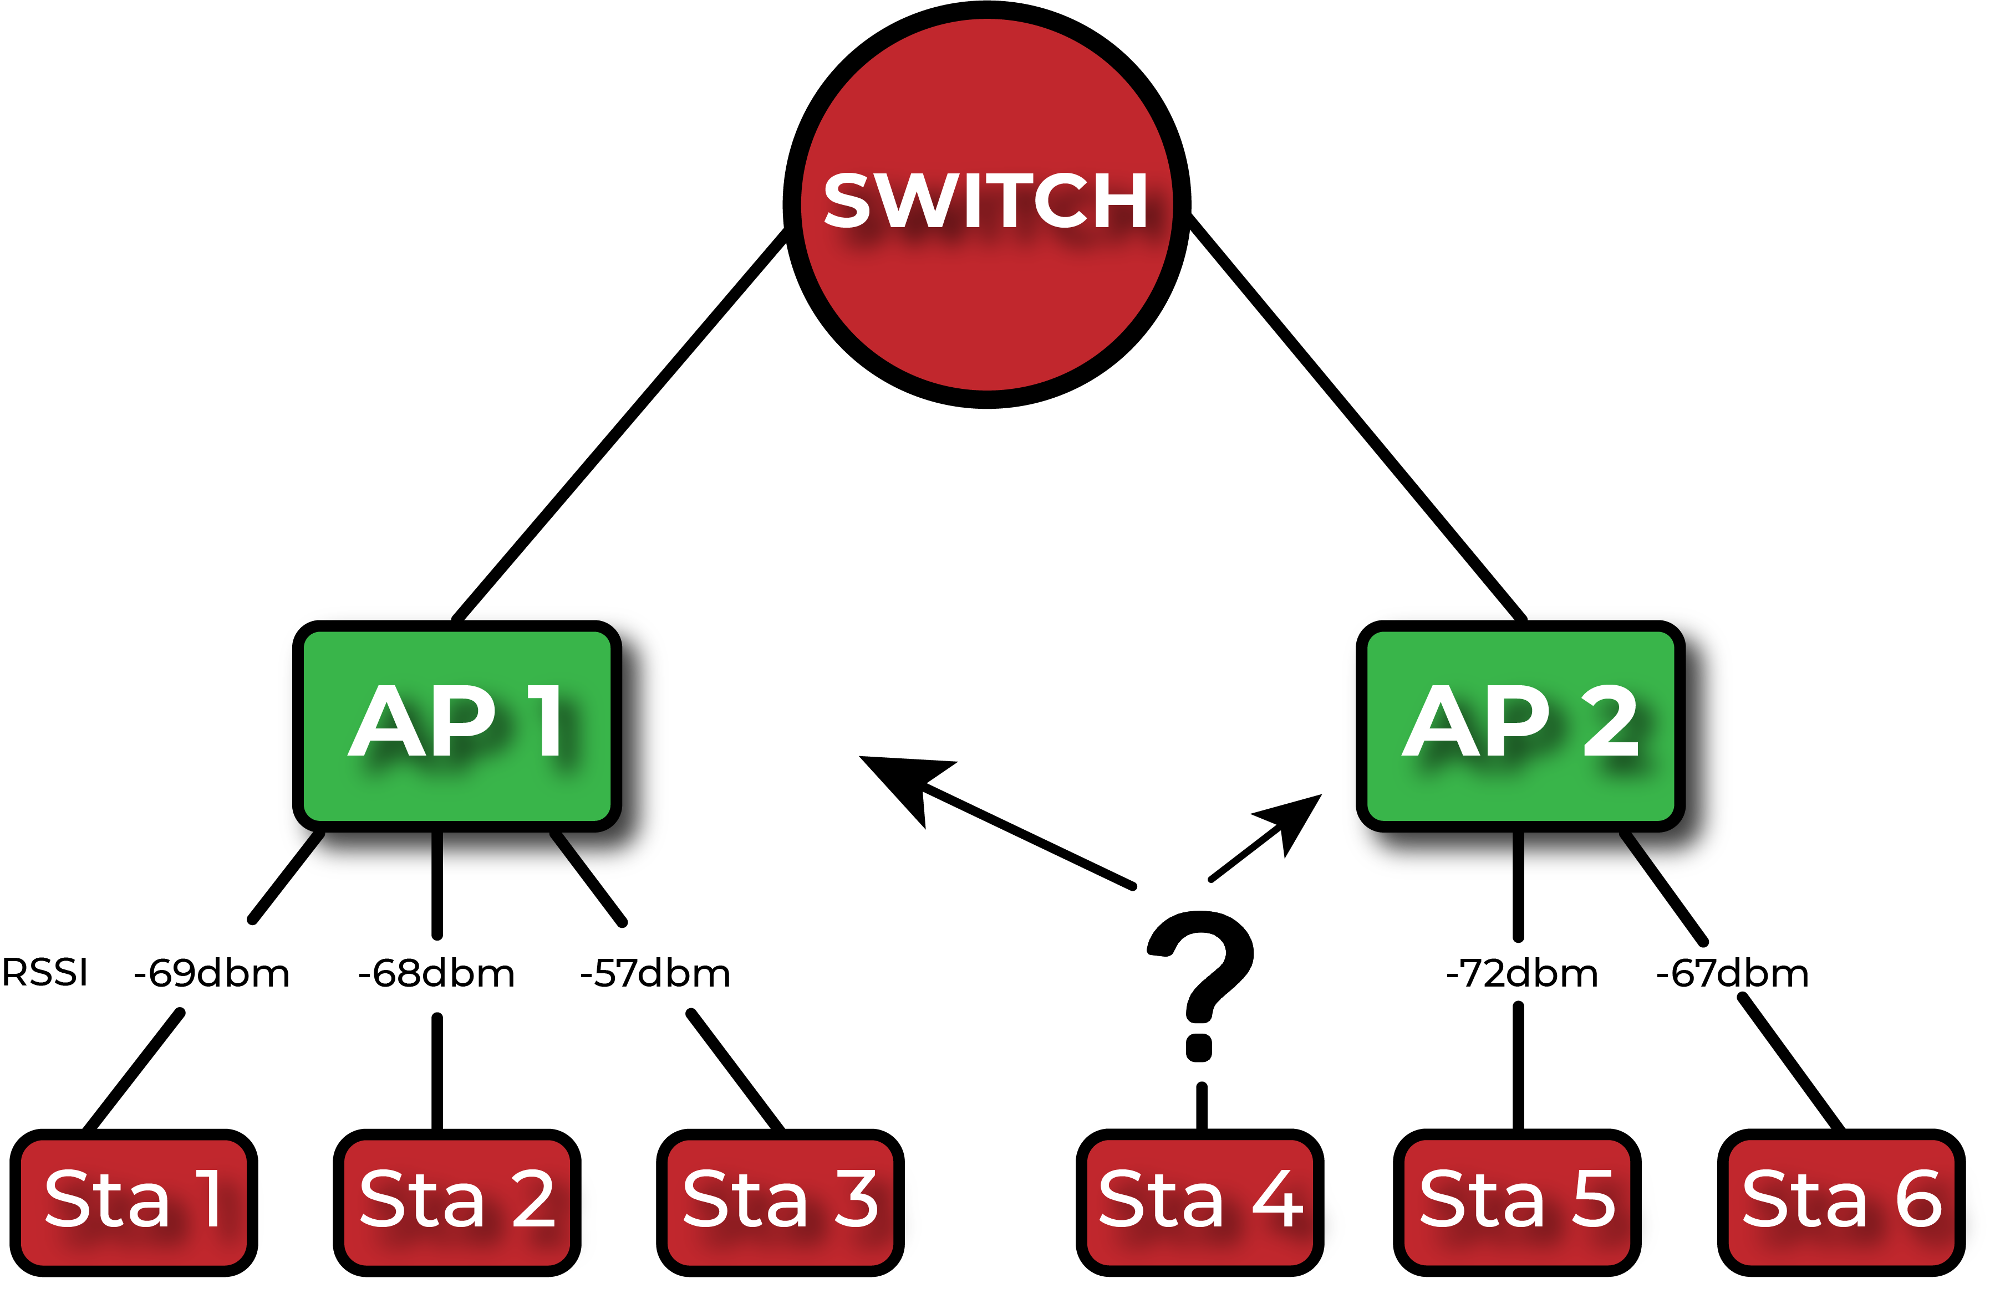
PROBLEM STATEMENT
The client initiates the handoff and lacks the knowledge of which AP to connect to deteriorating the quality of service (QoS) and resulting in significant handoff time.
FIGURE 1 Handoffs in Wi-Fi networks

Slide 5
SOLUTION TO THE PROBLEM – DiDe Theory
Our solution focuses on reducing the handoff times by considering the traffic load and RSSI values on the APs together.
Considering the Traffic Load minimizes the number of handoffs as the Destination AP selected by the Controller guarantees the QoS.
In this approach we use the centralized controller which take the TWO important decisions on the bases of RSSI Value + Traffic Load.
when the handoff is needed and
which destination AP to associate to

Slide 6
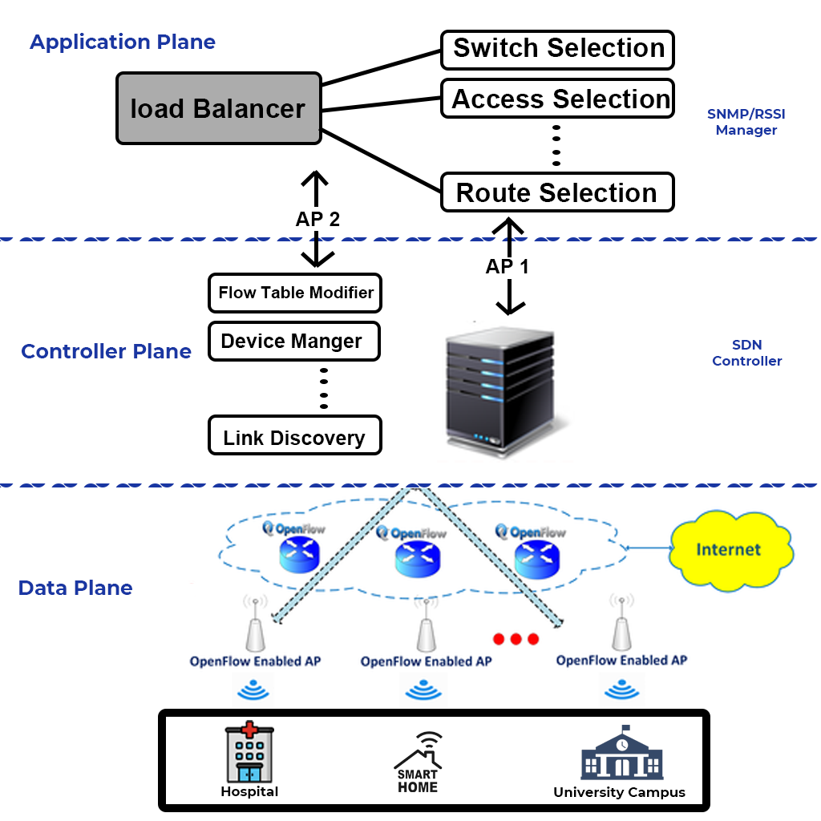
SOLUTION TO THE PROBLEM – DiDe Theory
The architecture consists of Three planes:
Application plane
control Plane
Data plane
The Data Plane depicts applications such as smart homes, healthcare, or campus Wi-Fi where the wireless devices connected to a Wi-Fi network Undergo Handoffs.
FIGURE 2 Architecture of DiDe

Slide 7
SOLUTION TO THE PROBLEM – DiDe Theory
In the Control Plane SDN Controller chooses a Destination AP for the De-associated Wireless Devices
In the Application Plane RSSI values are extracted from the packets exchanged between the wireless devices and the APs.
The traffic information on the APs is collected by the SNMP manager in the application plane.
The information helps the SDN controller in deciding a suitable destination AP.

Slide 8
OMNET++
We used OMNeT++ 4.6 for Networking Simulation in this Project.
Basically, OMNeT++ is a modular, component-based C++ simulation library and framework, primarily for building network simulators.
For the Simulation on OMNet++, we used JDK (Java Development Kit) and Eclipse.
JDK is a development environment for building network applications
Eclipse is written mostly in Java and its primary use is for developing Java applications, but it may also be used to develop applications in other programming languages via plug-ins, including C++.

Slide 9
CONCLUSION
The simulation results show that the DiDe significantly reduces the handoff times by 60–70% and reduces the average number of retransmission by 4–49%.
Hence maintaining the throughput for delay sensitive applications such as OTP, when compared to the standard RSSI-based handoff scheme.
Channel measurement-based access selection scheme (CMAS) and Downlink-signal to interference plus noise ratio(DL-SINR) AP selection scheme (DASA).

Slide 10
CONCLUSION
TECHNIQUES | SELECTION METHODS | THROUGHPUT | AVERAGE NUMBER OF RETRANSMISSION
TRADITIONAL WI-FI | RSSI Value | Poor | 49% as compared to DiDe
DL-SINR | Downlink to signal noise ratio | Good | 7% as compared to DiDe
CMAS | Bandwidth | Better | 4% as compared to DiDe
DIDE | RSSI + Traffic | Best | Very Low

